Slide 1

🅿️ark 🅿️al
CSE 335 Class Project
Mudit Arora
ASU ID: 1220278488

Slide 2
Project Idea
One of my friends suggested this app idea.
People tend to have issues finding parking.
User-friendly app
Add your favorites to never forget!

Slide 3
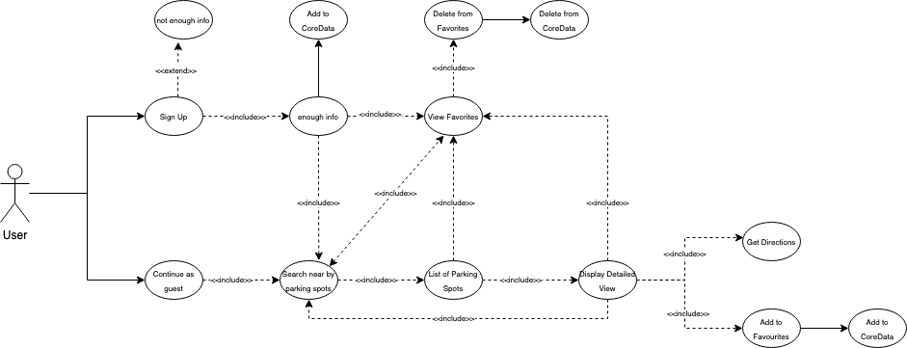

Slide 4
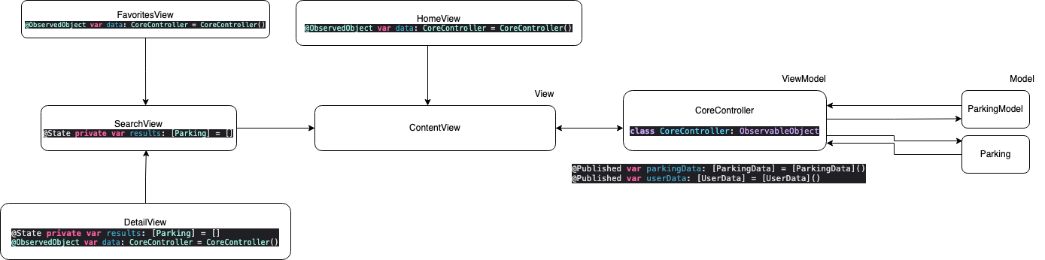

Slide 5
Capabilities of the project
No need to worry about making an account to use the app.
Get all the possible options available nearby.
Get a detailed view including name, address, and rating.
Add your favorite spots!
Get directions from your current location.
Add an account if you’re a frequent user.

Slide 6
Limitations of the project
Limited to only a few pieces of information given by the API.
Difficult to find the right API.
The reserve feature is hard to implement.

Slide 7
Suggestions for improvement for the class/project
Do proper research for your API beforehand.
Encourage to use of SwiftUI.
Introduce more libraries in class to have a hands-on.

